Slide 1
Data scientist for a day
Laura Da Silva, Founder of IWDS and Microsoft AI MVP @lauradatasci @wogisci

Slide 2
Topics for today:
Intro to data science
Skills to become a data scientist
Data science applications
Intro to machine learning
Getting started with Azure ML Studio

Slide 3

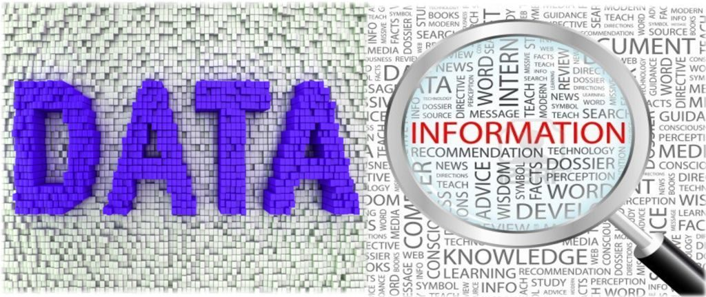

What is Data Science?

Slide 4
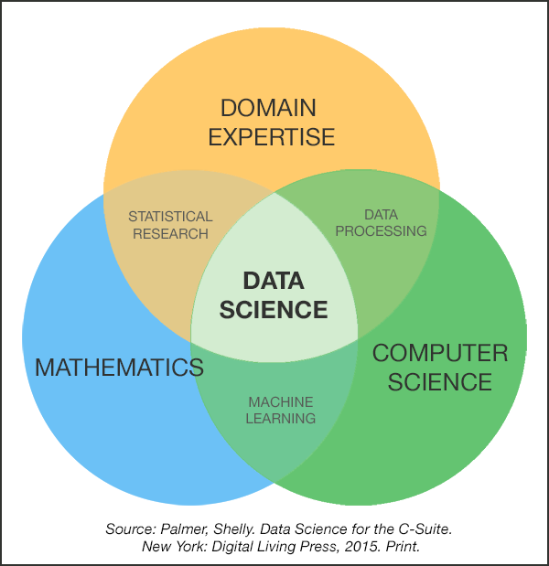
What to learn to become a Data Scientist?

Slide 5
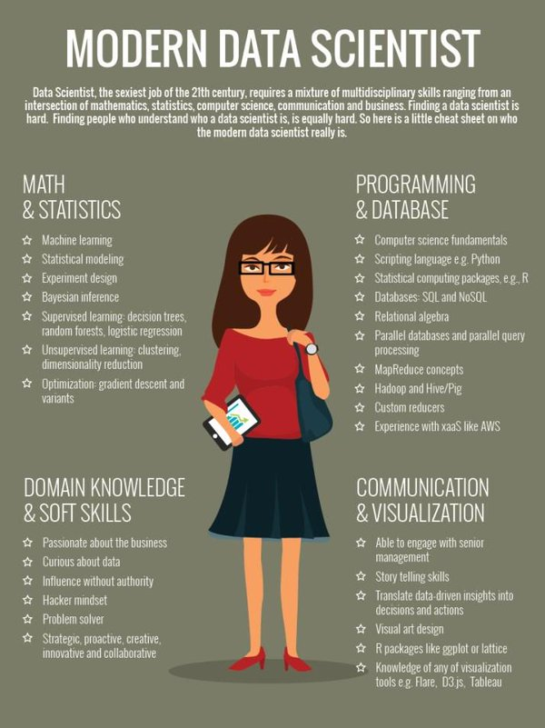
What skills are expected from a Data Scientist?
Experience coding (SQL, R, Python)
Machine Learning (Maths & Statistics)
Curious about data
Good communicator: Translate data-driven insights into decisions and actions

Slide 6
General skills for becoming a Data Scientist
Problem Solving Skills
Patience
Coding Skills
Creativity
(Think outside the box)
Intellectual Curiosity
Resilience
Communication Skills
Machine Learning / Data Mining Skills
Big Initiative

Slide 7
Because in your every day you will be …
Solving problems for getting the best solution for your client/company
Understanding data and business objectives
Transforming data to give it a coherent and useful form
Implementing new algorithms to make predictions on data
Studying and using models to understand specific data
Using feedback to learn how to improve your solution or make better predictions

Slide 8
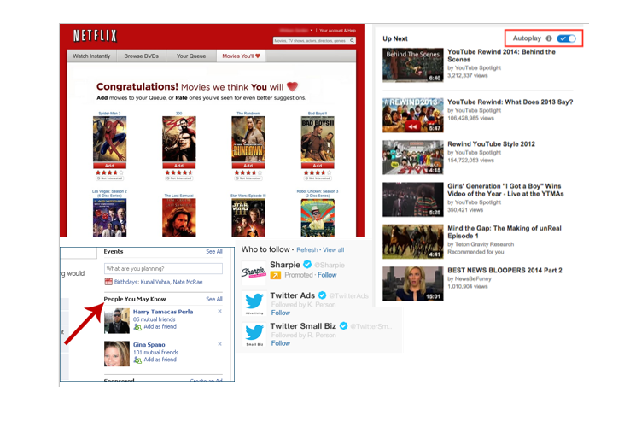
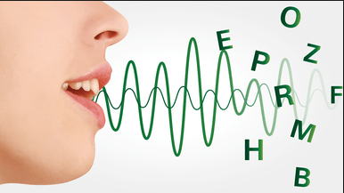

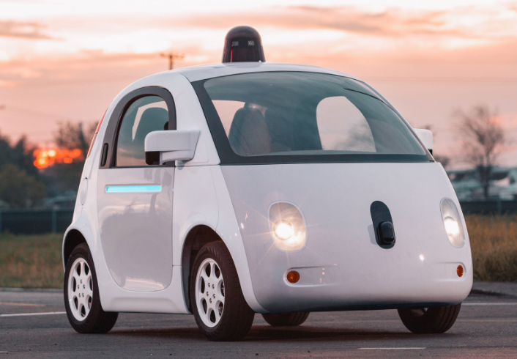

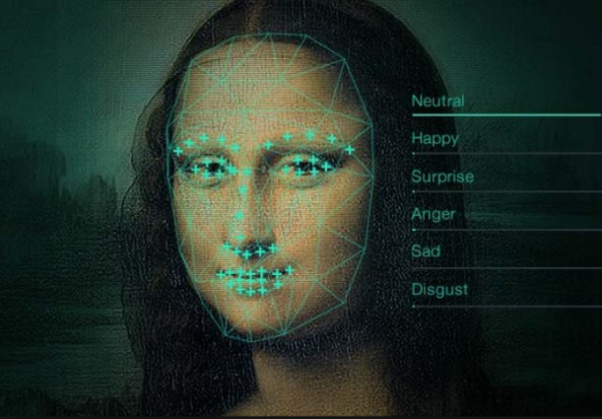
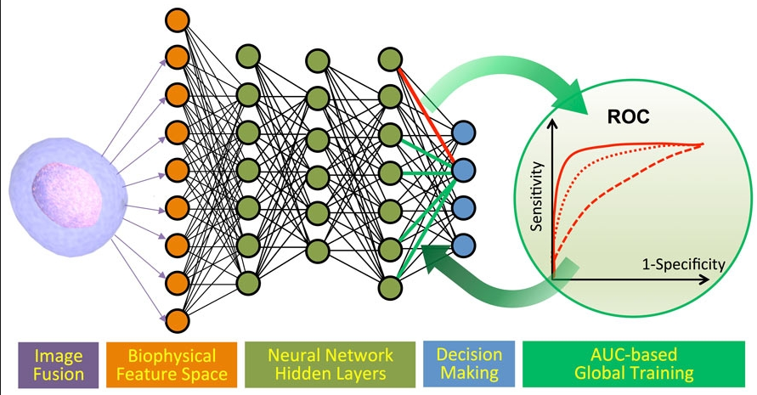
Data Science Applications
Current Trends
Recommender Systems
Speech recognition
Fraud detection
Facial identification/recognition
Health (detection of cancer)
Self Driving cars
Smart houses

Slide 9
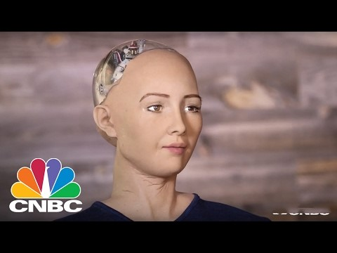
Data Science Applications

Slide 10
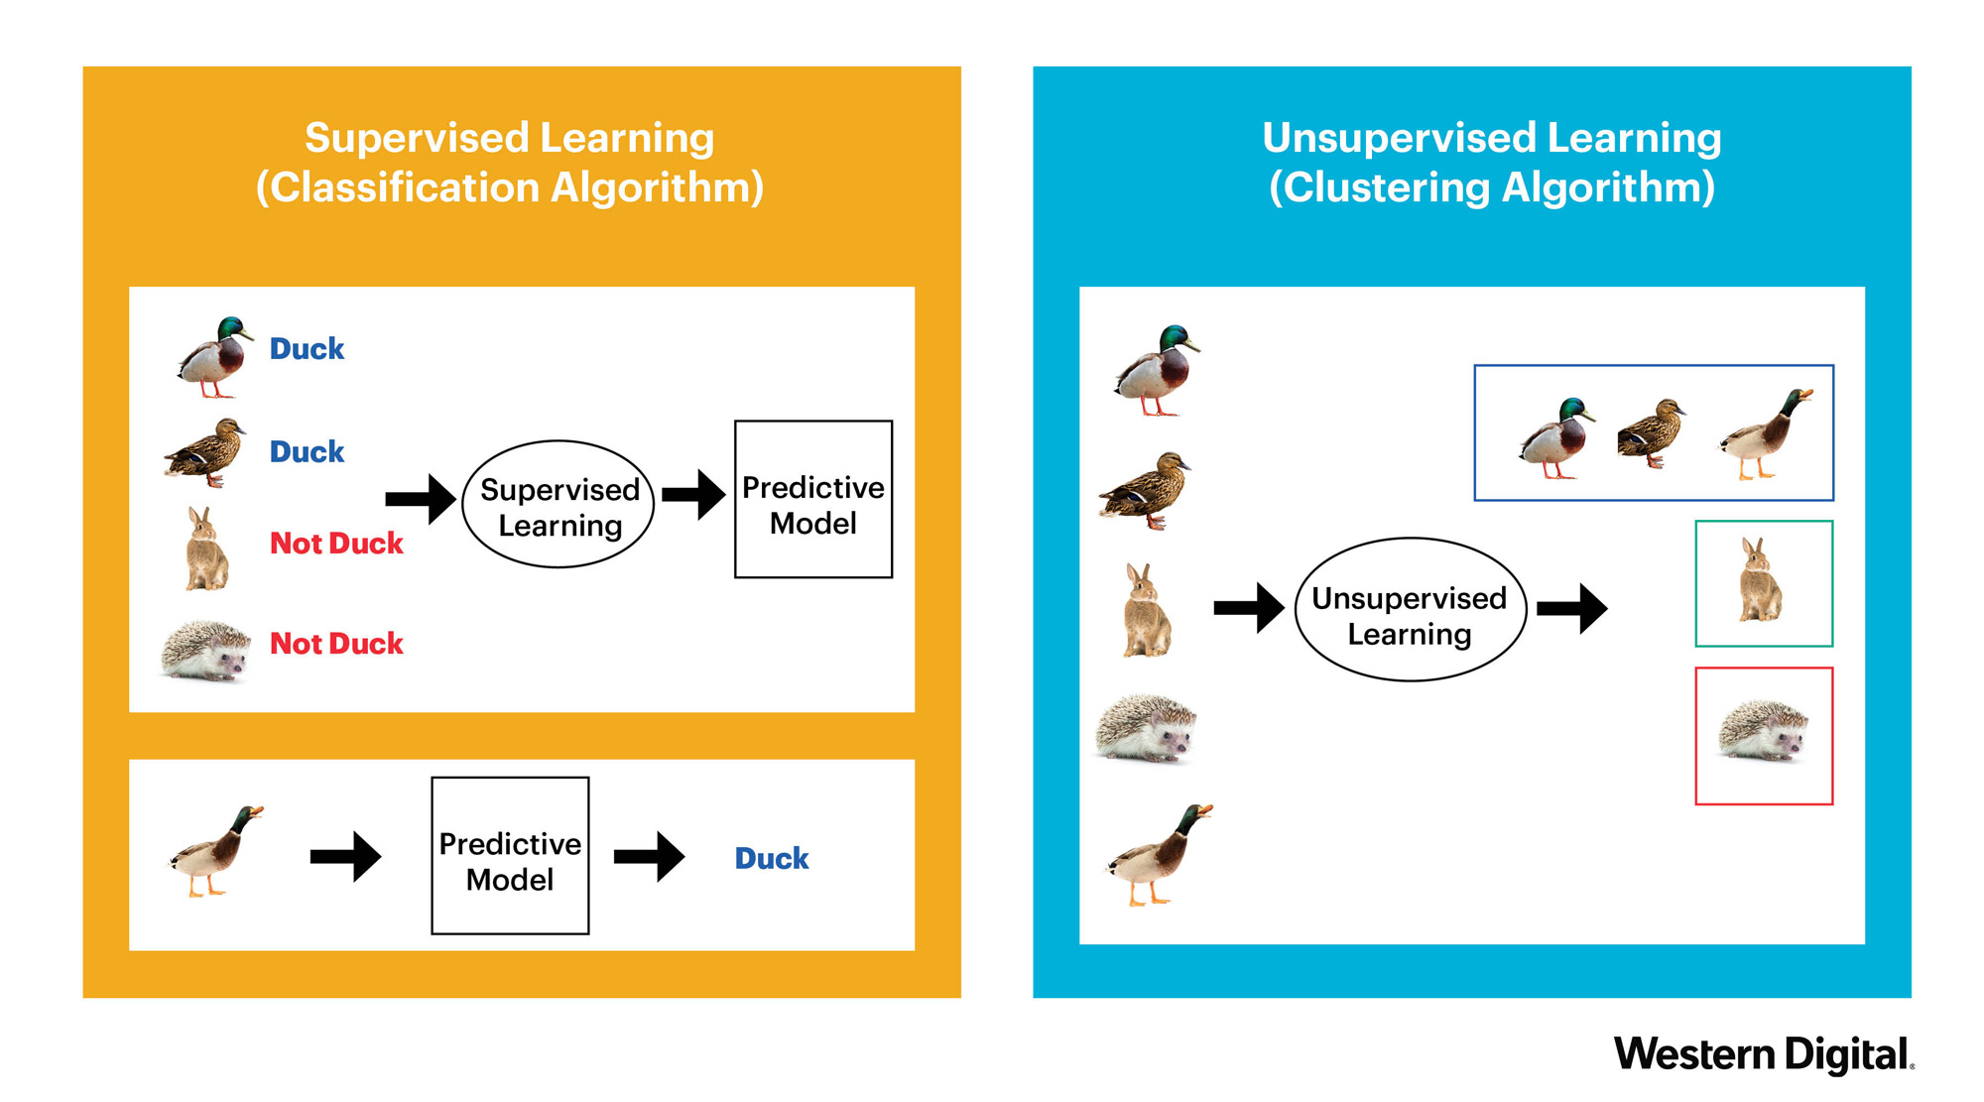
Intro to Machine learning
With labels
Without labels

Slide 11
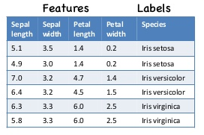
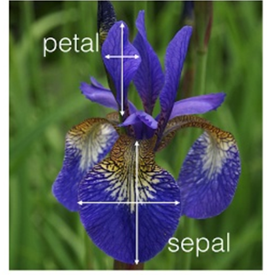

Example: Iris flower

Slide 12
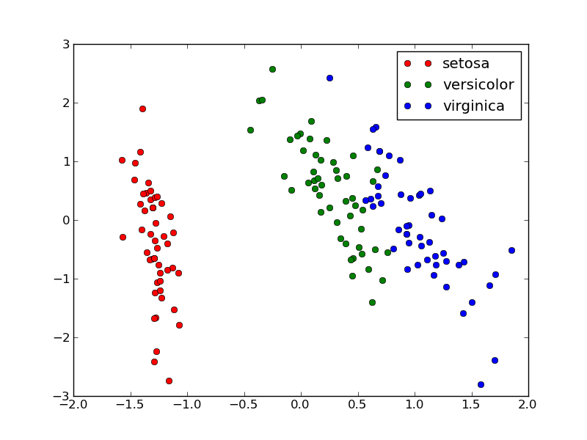
Unsupervised Learning
Definition
You give the input data (X) and no corresponding output variables (labels).
Techniques
Clustering: you want to discover the inherent groupings in the data. Association: you want to discover rules that describe large portions of your data.

Slide 13
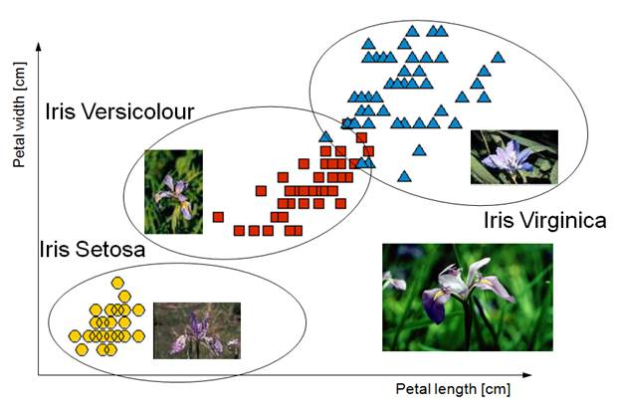
Supervised Learning
Definition
You give the input data (X) and an output variable (Y) (labels), and you use an algorithm to learn the mapping function from the input to the output. Y = f(X)
Techniques
Classification: you want to classify a new input value. Regression: you want to get a function that fit really well the data so you can predict the future.

Slide 14
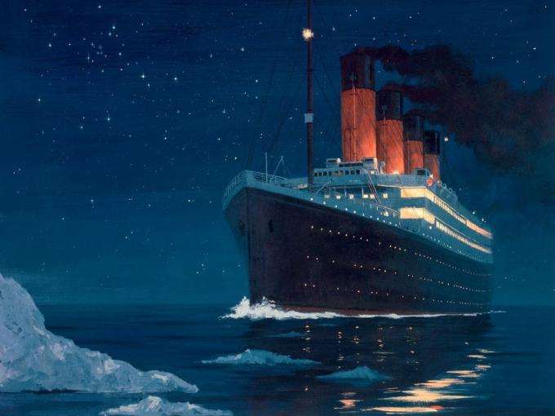
Supervised learning example: Titanic survivor predictor
The titanic survivor predictor example will predict the probability of surviving in the Titanic based on data about passengers on the Titanic.
Go to the following link: https://docs.microsoft.com/en-us/azure/machine-learning/studio/excel-add-in-for-web-services
Let’s explore the dataset
2. Let’s follow the instructions together to get our predictions

Slide 15
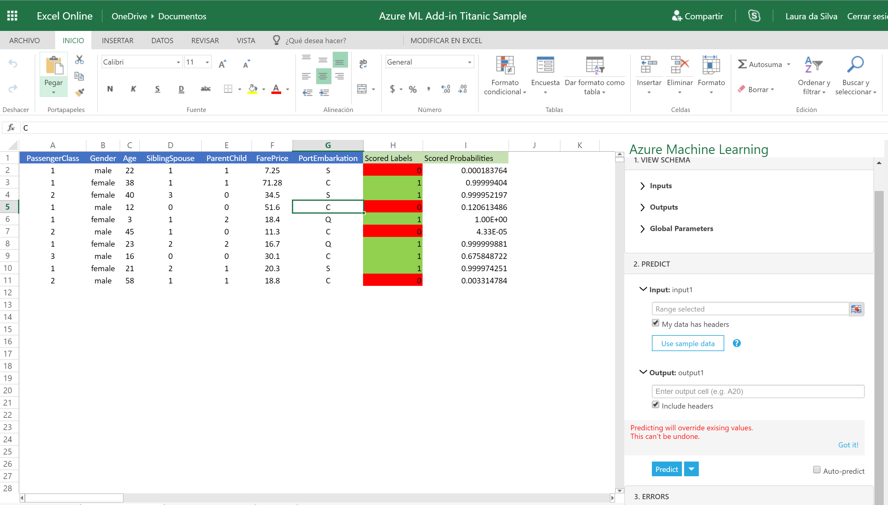
Prediction using an already deployed model

Slide 16
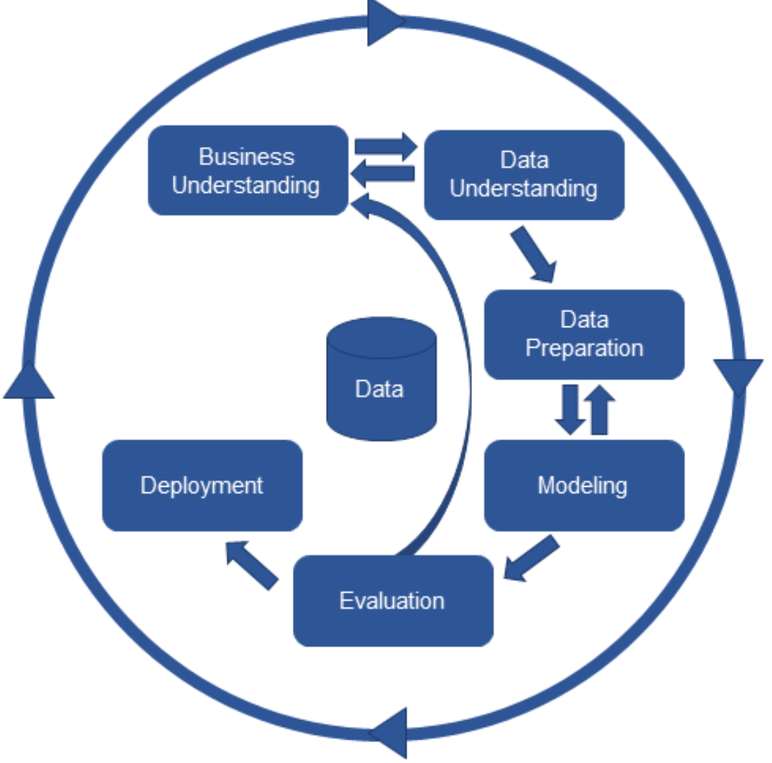
Data Science cycle
Titanic Survivor Predictor
Data format
Delete empty and weird values
Deploy a web service that other people can use
Binary classifier (1: survived,
0: not survived)
How well is the machine learning? Confusion matrix

Slide 17
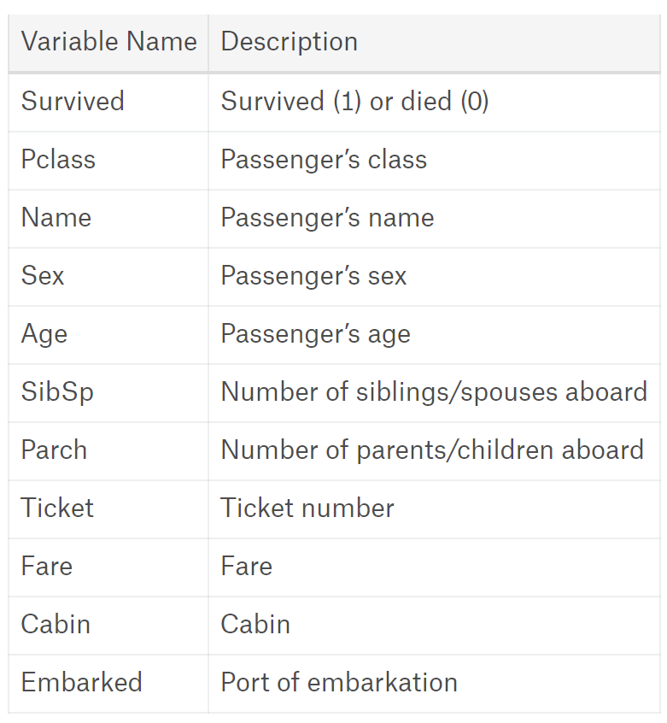
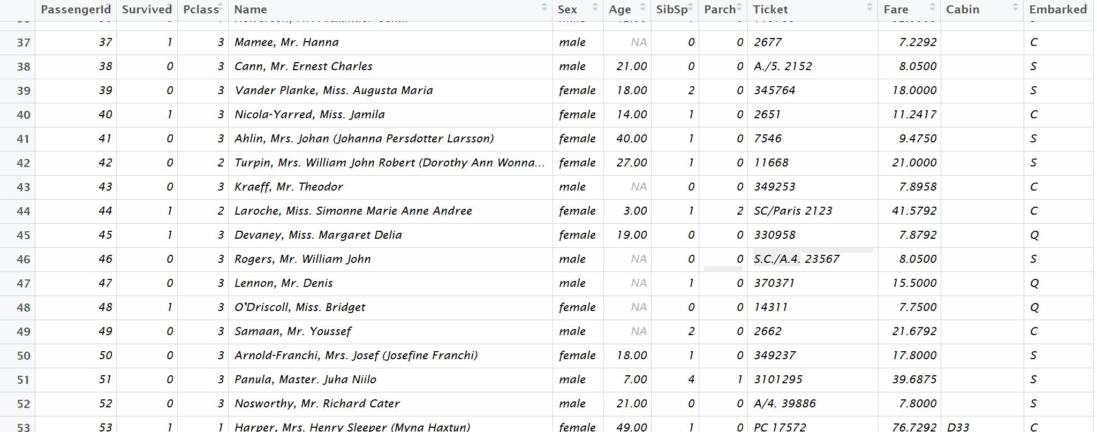
The ORIGINAL Dataset
The original dataset usually has to be transformed in order to be used
Data Dictionary

Slide 18
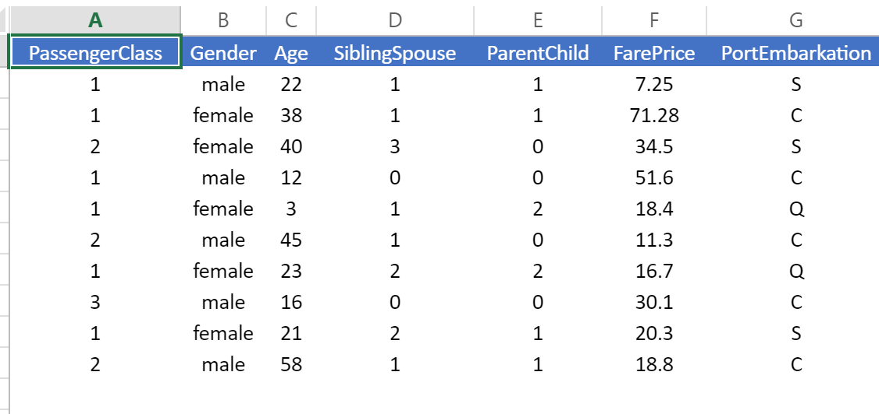
Final dataset
Attributes or features
Observations
Numerical Data
Categorical Data

Slide 19
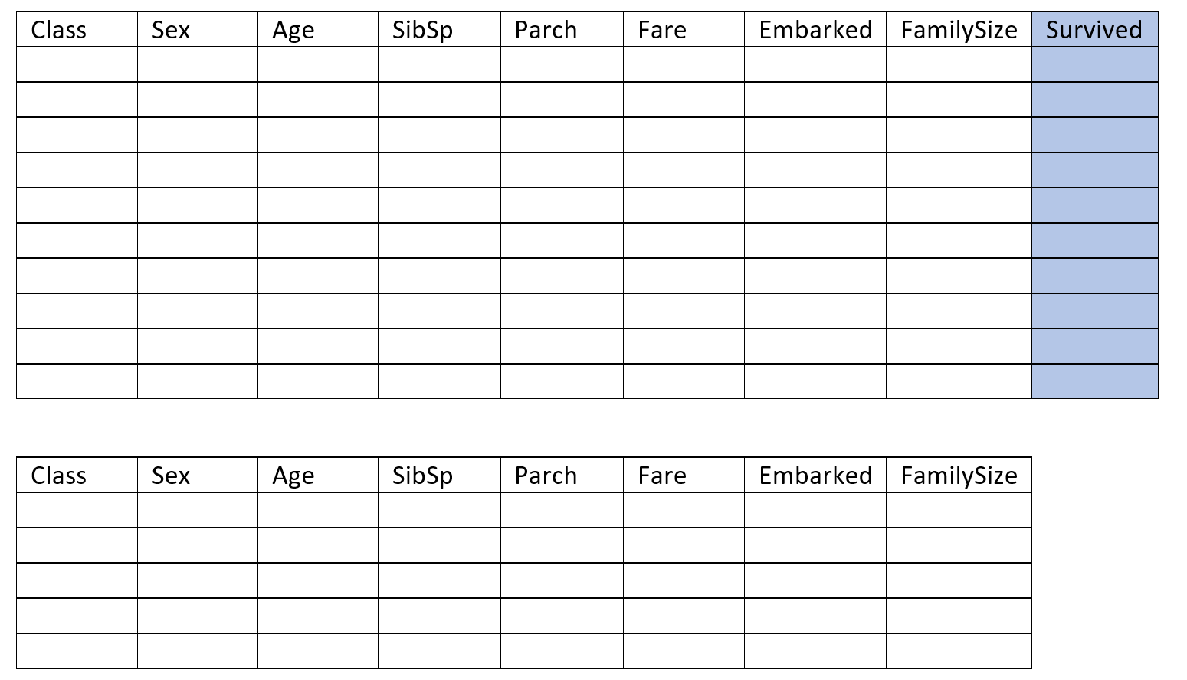
Splitting the data for training and testing
70%
30%

Slide 20
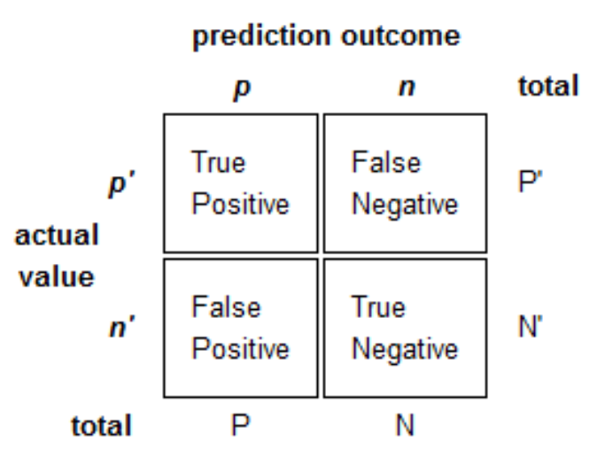
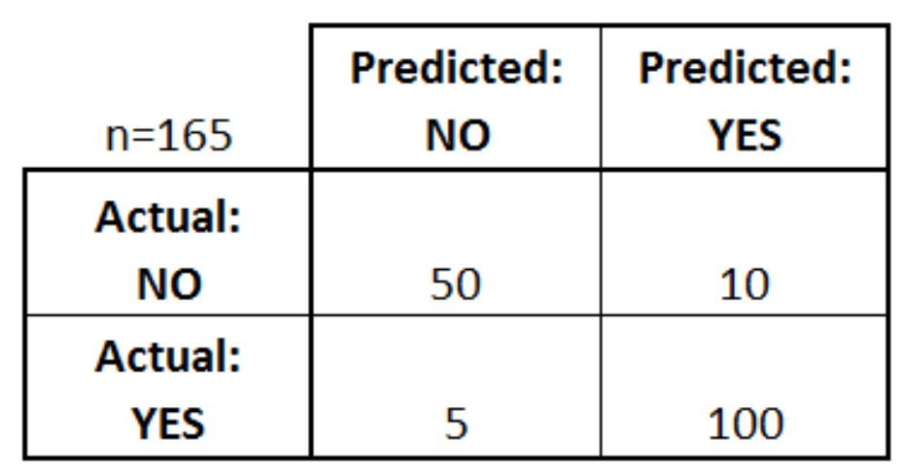
Model evaluation: the confusion matrix

Slide 21
Create your first experiment in Azure Machine Learning Studio
Sign in Azure Machine Learning Studio: https://studio.azureml.net/
Let’s follow the tutorial of creating an experiment in Azure ML for Income prediction.
Details about the dataset can be found at: https://archive.ics.uci.edu/ml/datasets/adult

Slide 22
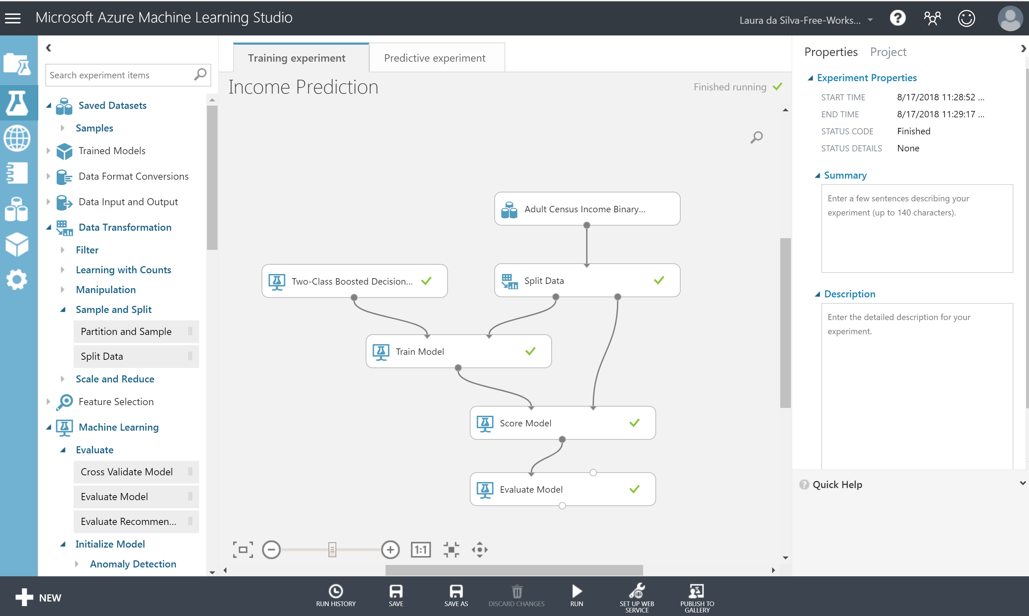
The training experiment

Slide 23
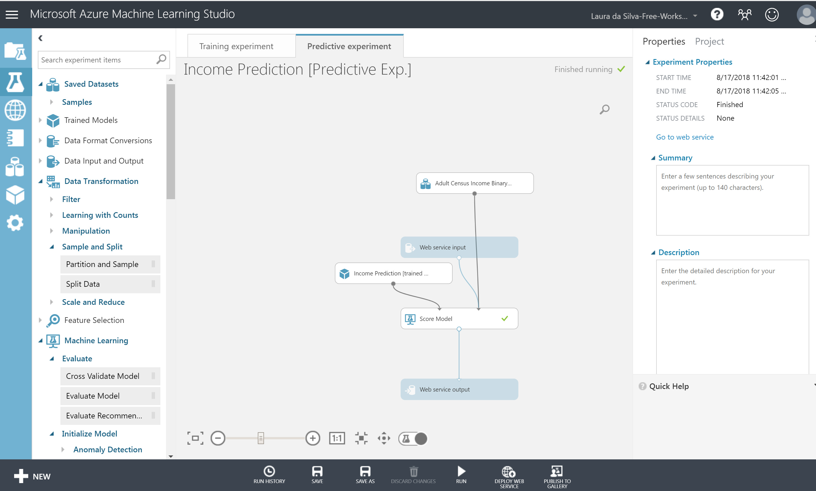
The predictive experiment

Slide 24
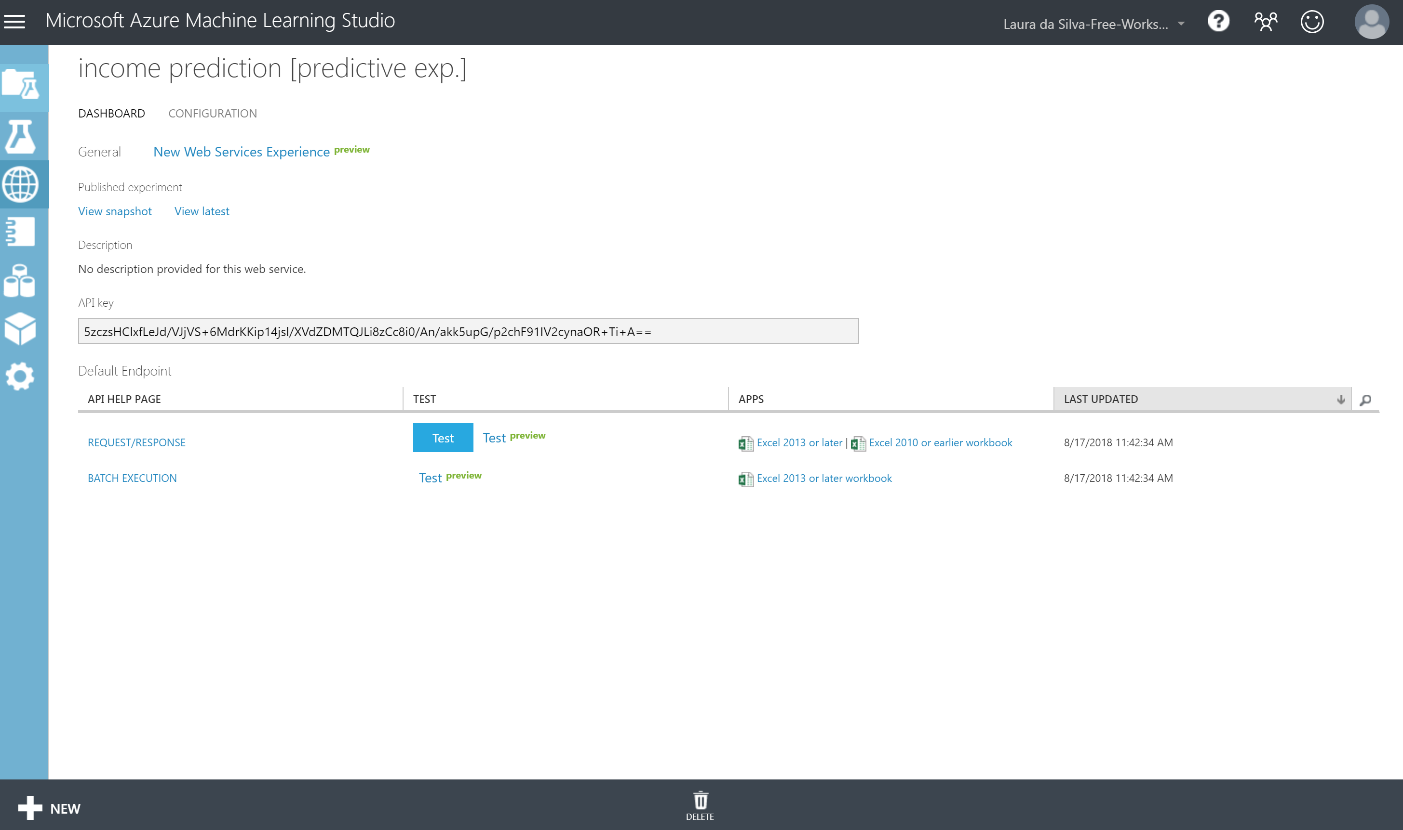
The web service details

Slide 25
Challenges
Looking at examples you will find in the Gallery (https://gallery.azure.ai/):
Create the experiment for the Titanic survivor predictor.
Create the experiment for Sentiment analysis using messages from Twitter.
Create an experiment for movie recommendation.

